Slide 1
Learning Objective
I will be able to determine the constant of proportion for related variables
Success Criteria
At the end of the lesson, I will be able to:
understand the concept of direct proportion and be able to determine the constant of proportionality for related variables;
understand the concept of inverse proportion and be able to determine the constant of inversely proportionality for related variables;

Slide 2
Skill Development
A few years ago I was on a road trip to Albany from Perth. As soon as I leave metropolitan Perth, I was able to use my cruise control on my car to keep the speed of my car stable at 100 km/h.

Slide 3
Skill Development
Observations:
If t is double, I will go twice as far. If t is triple, I will go trice as far.
The relationship is a linear relationship – straight line.
We can say that the distance varies with time.

Slide 4

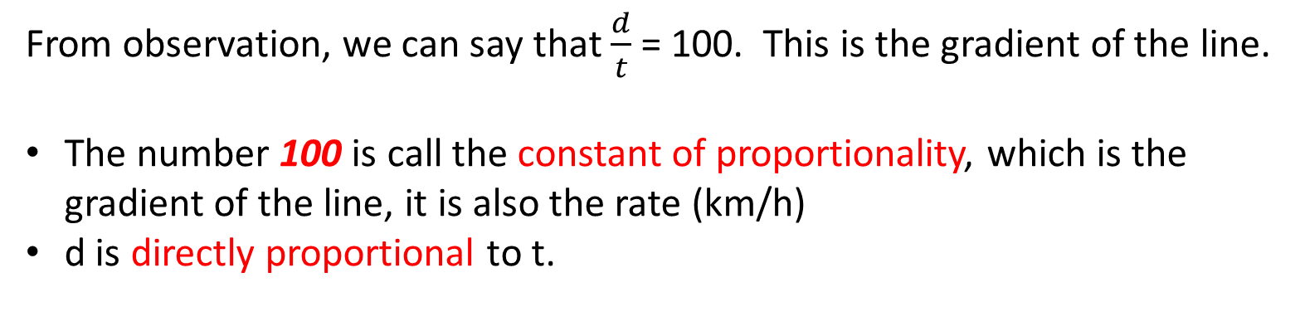
Skill Development
Gradient for the 1st hour: $\frac{100}{1}$ = 100
Gradient for the 2nd hour: $\frac{200}{2}$ = 100
Gradient for the 3rd hour: $\frac{100}{3}$ = 100
From observation, we can say that $\frac{d}{t}$ = 100. This is the gradient of the line.
The number 100 is call the constant of proportionality, which is the gradient of the line, it is also the rate (km/h)
d is directly proportional to t.

Slide 5
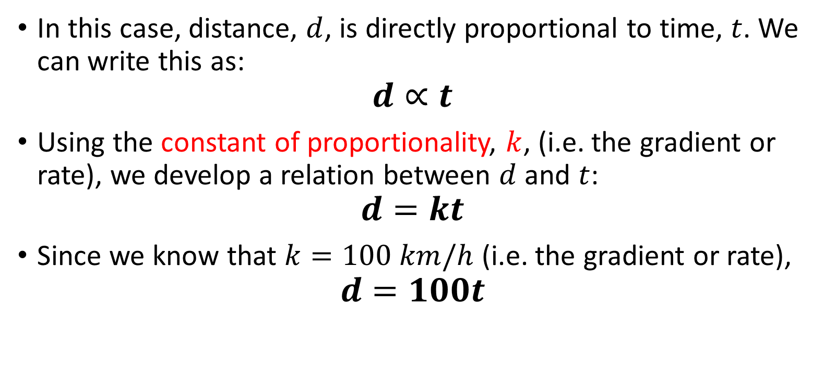
Notation
Concept Development
In this case, distance, $d$, is directly proportional to time, $t$. We can write this as:
$$d∝t$$
Using the constant of proportionality, $k$, (i.e. the gradient or rate), we develop a relation between $d$ and $t$:
$$d=kt$$
Since we know that $k=100 km/h$ (i.e. the gradient or rate),
$$d=100t$$

Slide 6

Direct Proportion
Concept Development
When $y$ is said to be directly proportionately or vary directly with $x$, we say that $y∝x$
The rule relating x and y is y = kx
That is, a straight line of gradient k
Passing through the point (0,0)

Slide 7
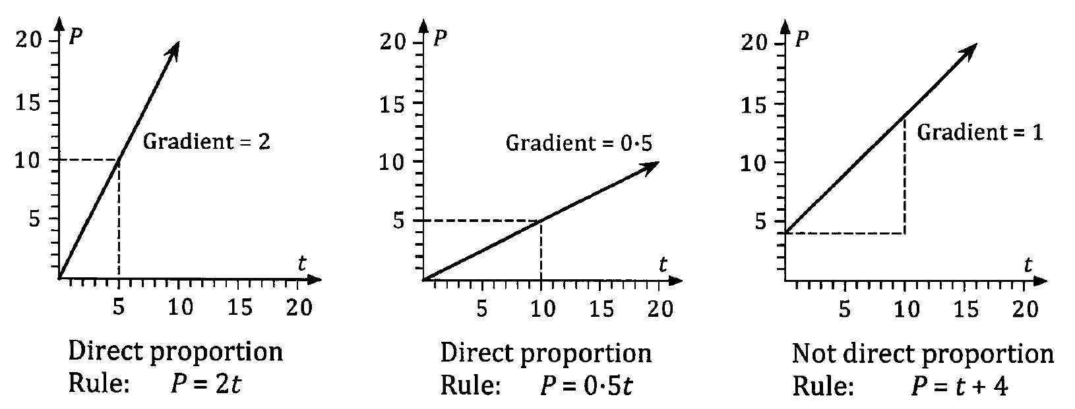
Concept Development

Slide 8
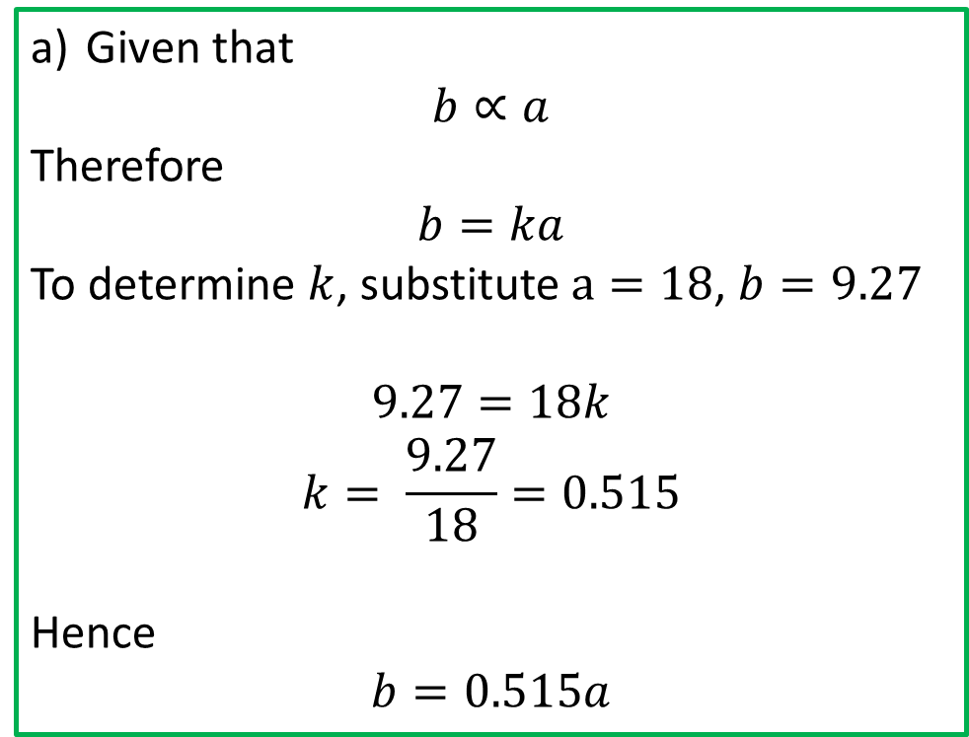
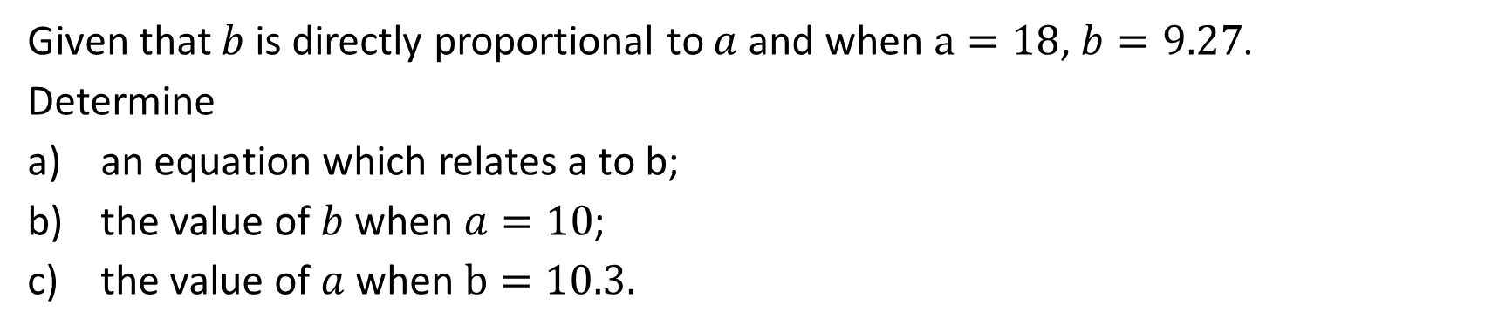
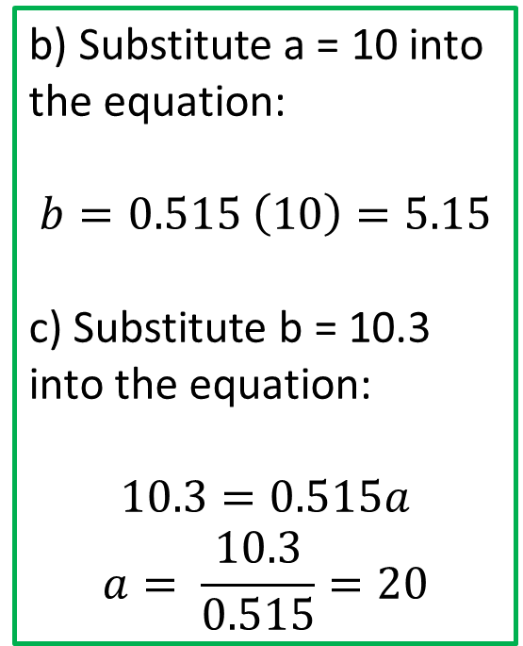
Practice
Given that $b$ is directly proportional to $a$ and when $a=18$, $b=9.27$.
Determine
an equation which relates a to b;
the value of $b$ when $a=10$;
the value of $a$ when $b=10.3.$
Given that
$$b∝a$$
Therefore
$$b=ka$$
To determine $k$, substitute $a=18$, $b=9.27$
$$9.27=18k$$
$$k= \frac{9.27}{18}=0.515$$
Hence
$$b=0.515a$$
b) Substitute a = 10 into the equation:
$$b=0.515 \left(10\right)=5.15$$
c) Substitute b = 10.3 into the equation:
$$10.3=0.515a$$
$$a= \frac{10.3}{0.515}=20$$

Slide 9
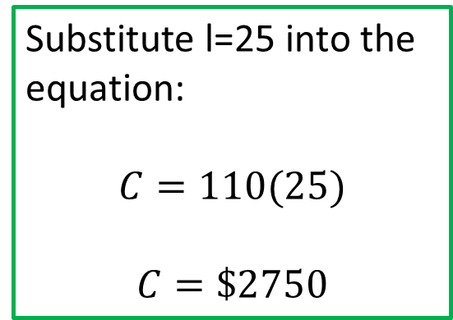
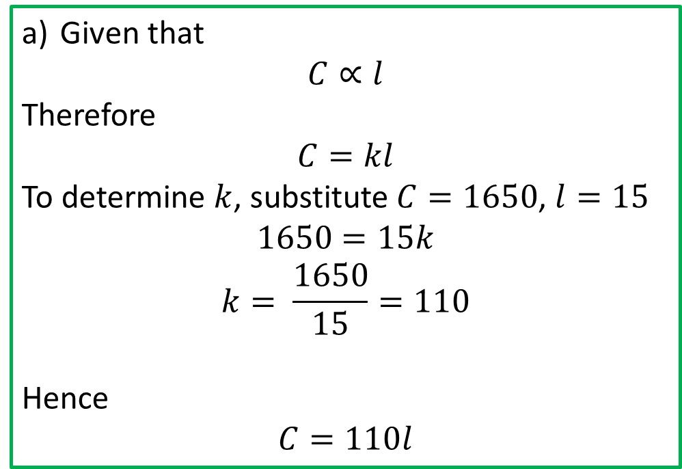
Practice
The cost ($C) of a particular type of carpet is directly proportional to the length (l) of the carpet. If 15m of the carpet cost $1650, determine the cost of 25m of the carpet.
Given that
$$C∝l$$
Therefore
$$C=kl$$
To determine $k$, substitute $C=1650$, $l=15$
$$1650=15k$$
$$k= \frac{1650}{15}=110$$
Hence
$$C=110l$$
Substitute l=25 into the equation:
$$C=110(25)$$
$$C=\$2750$$

Slide 10
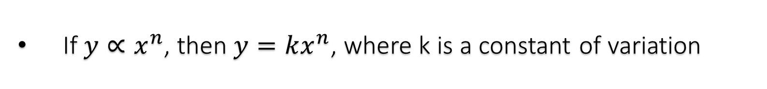
Direct Proportion involving powers
Concept Development
If $y∝x^{n}$, then $y=kx^{n}$, where k is a constant of variation
The graph will also pass through the point (0, 0)

Slide 11
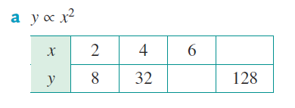
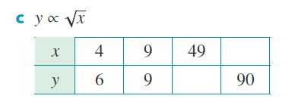




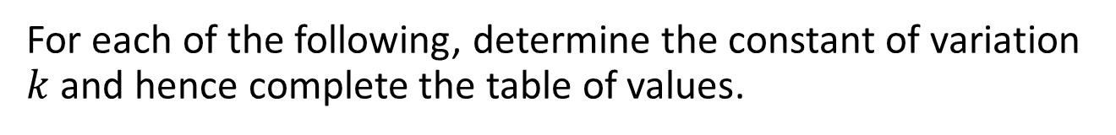








Cambrdige Ex 5A Q1
For each of the following, determine the constant of variation $k$ and hence complete the table of values.
$$8$$
$$900$$
$$72$$
$$21$$
$$y=kx^{2}$$
$$y=k\sqrt{x}$$
$$\left(2,8\right), 8=k{(2)}^{2}$$
$$\left(4,6\right), 6=k\sqrt{4}$$
$$k=\frac{8}{4}=2$$
$$k=\frac{6}{2}=3$$
$$y=2x^{2}$$
$$y=3\sqrt{x}$$

Slide 12
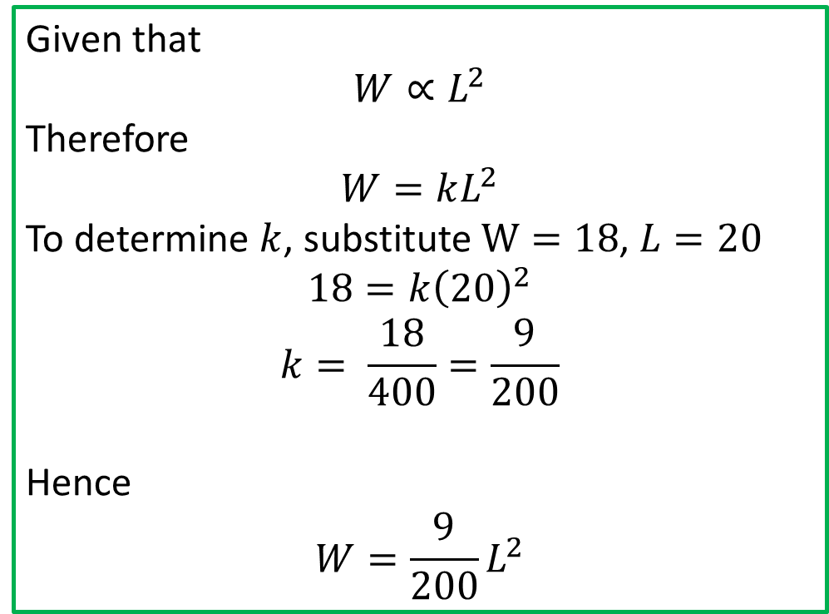
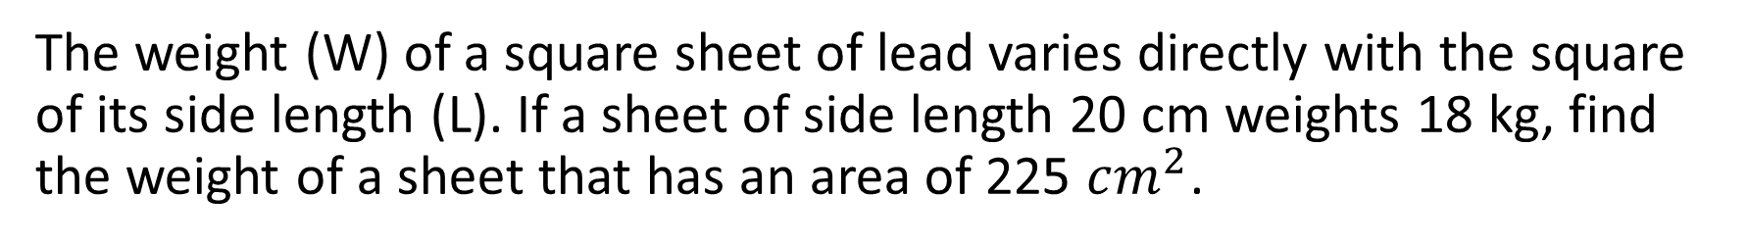
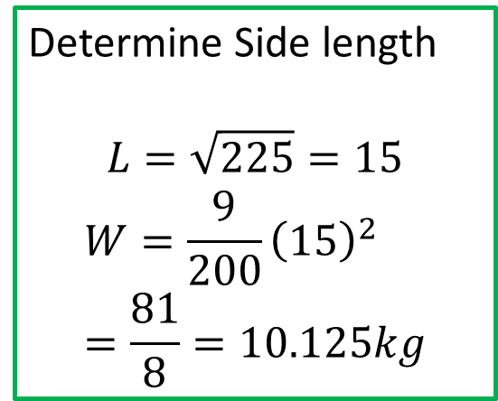
Cambridge Ex 5A Q6
The weight (W) of a square sheet of lead varies directly with the square of its side length (L). If a sheet of side length 20 cm weights 18 kg, find the weight of a sheet that has an area of 225 $cm^{2}$.
Given that
$$W∝L^{2}$$
Therefore
$$W=kL^{2}$$
To determine $k$, substitute $W=18$, $L=20$
$$18=k{\left(20\right)}^{2}$$
$$k= \frac{18}{400}=\frac{9}{200}$$
Hence
$$W=\frac{9}{200}L^{2}$$
Determine Side length
$$L=\sqrt{225}=15$$
$$W=\frac{9}{200}{\left(15\right)}^{2} \\ =\frac{81}{8}=10.125kg$$

Slide 13
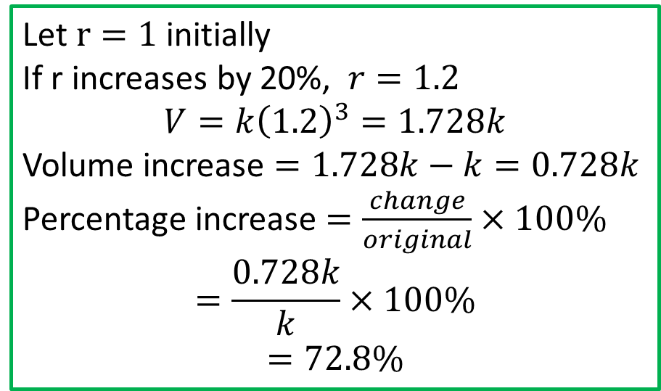
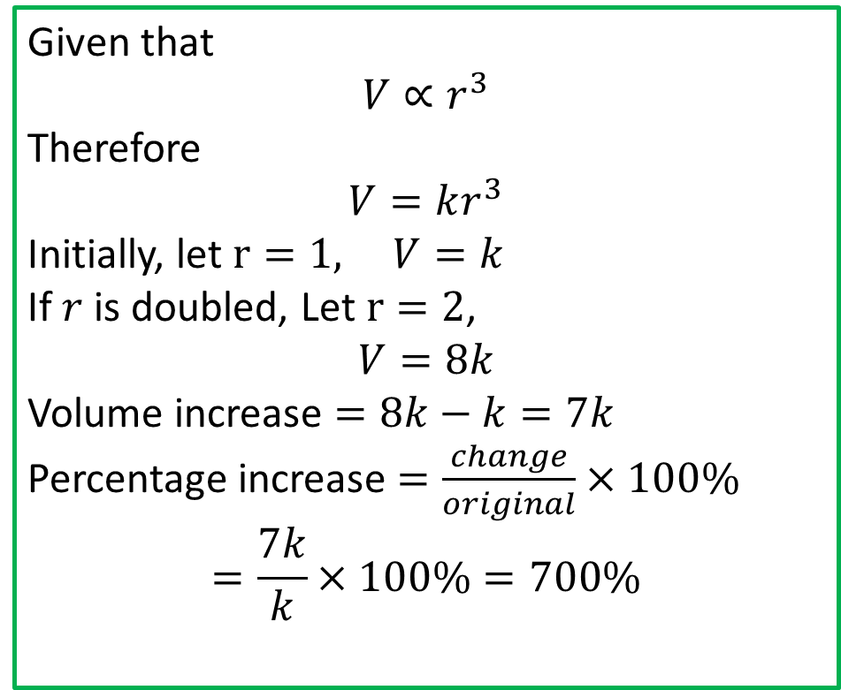
Cambridge Ex 5A Ex 3
The volume of a sphere varies directly as the cube of its radius. By what percentage will the volume increase if the radius is
a) Doubled b) increased by 20%
Given that
$$V∝r^{3}$$
Therefore
$$V=kr^{3}$$
Initially, let $r=1, V=k$
If $r$ is doubled, Let $r=2$,
$$V=8k$$
Volume increase $=8k−k=7k$
Percentage increase $=\frac{change}{original}×100\%$ $$=\frac{7k}{k}×100\%=700\%$$
Let $r=1$ initially If r increases by 20%, $r=1.2$ $$V=k{\left(1.2\right)}^{3}=1.728k$$
Volume increase $=1.728k−k=0.728k$
Percentage increase $=\frac{change}{original}×100\%$ $$=\frac{0.728k}{k}×100\%$$
$$=72.8\%$$

Slide 14
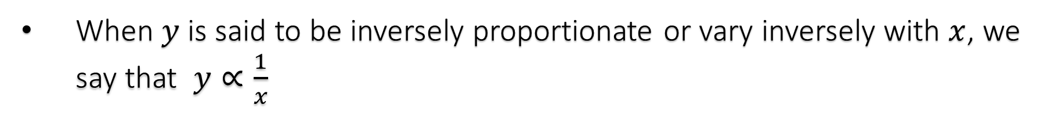
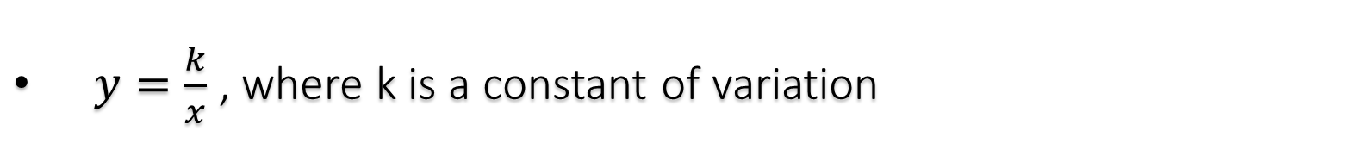

Inverse Proportion
Concept Development
When $y$ is said to be inversely proportionate or vary inversely with $x$, we say that $y∝\frac{1}{x}$
$y=\frac{k}{x}$ , where k is a constant of variation
If $y∝\frac{1}{x^{n}}$, then $y=\frac{k}{x^{n}}$, where k is a constant of variation

Slide 15
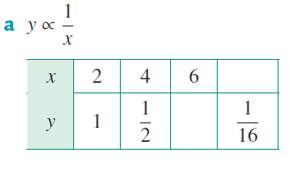
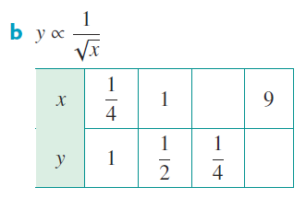



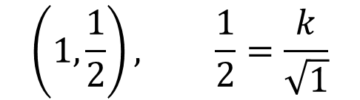

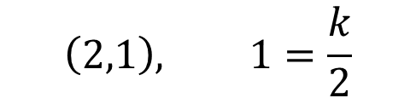
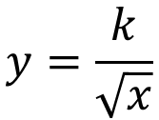
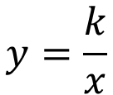



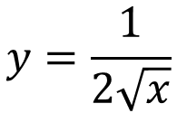
Cambridge Ex 5B Q1
For each of the following, determine the constant of variation $k$ and hence complete the table of values.
$$32$$
$$4$$
$$\frac{1}{3}$$
$$\frac{1}{6}$$
$$y=\frac{k}{x}$$
$$y=\frac{k}{\sqrt{x}}$$
$$\left(2,1\right), 1=\frac{k}{2}$$
$$\left(1,\frac{1}{2}\right), \frac{1}{2}=\frac{k}{\sqrt{1}}$$
$$k=2$$
$$y=\frac{2}{x}$$
$$k=\frac{1}{2}$$
$$y=\frac{1}{2\sqrt{x}}$$

Slide 16

Cambridge Ex 5B Ex 5
For a cylinder of fixed volume, the height (h) is inversely proportional to the square of the radius (r cm)
What percentage change in height would result if its radius were reduced by 25%?
If a cylinder of height 15 cm has a base radius of 4.2 cm, how high would a cylinder of equivalent volume be if its radius were 2.5 cm?
Given that
$$h∝\frac{1}{r^{2}}$$
Therefore
$$h=\frac{k}{r^{2}}$$
Initially, let $r=1, h=k$
If $r$ is reduced by 25%, Let $r=0.75$,
$$h=\frac{k}{{0.75}^{2}}≈1.778k$$
Height increase $=0.778k$
Percentage increase $=\frac{change}{original}×100\%=\frac{0.778}{k}×100\%=77.8\%$

Slide 17

Cambridge Ex 5B Ex 5
For a cylinder of fixed volume, the height (h) is inversely proportional to the square of the radius (r cm)
What percentage change in height would result if its radius were reduced by 25%?
If a cylinder of height 15 cm has a base radius of 4.2 cm, how high would a cylinder of equivalent volume be if its radius were 2.5 cm?
Given that
$$h=\frac{k}{r^{2}}$$
let $r=4.2, h=15$
$$15=\frac{k}{{4.2}^{2}} \\ k=264.6$$
$$h=\frac{264.6}{r^{2}}$$
$$r=2.5, h=\frac{264.6}{{\left(3.5\right)}^{2}}=21.6 cm$$

Slide 18
Independent Practice
Complete Cambridge Ex 5A and 5B

